Slide 1

Volumes
Volumes in kubernetes allow you to store data outside the container
When a containers stops, all data on the container itself is lost
That’s why up until now I’ve been using stateless apps: apps that don’t keep a local state, but store theirs state in an external service
External Service like a database, cashing server ( e.g. MySQL, Postgresql)
Persistent Volumes in Kubernetes allow you attach a volume to a container that will exists even when the container stops

Slide 2
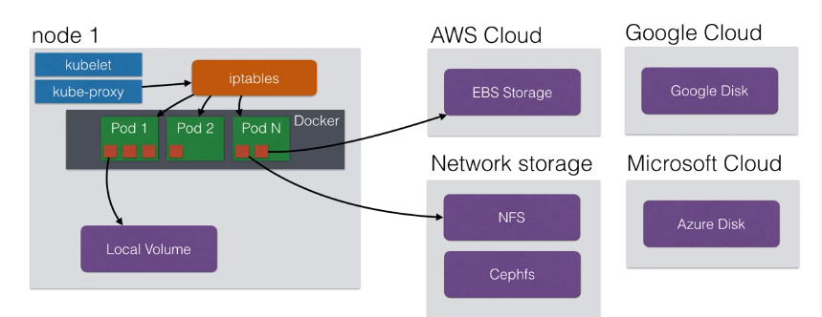
Kubernetes Volumes
Volumes can be attached using different volumes plugins:

Slide 3
Volumes
Using volumes, you could deploy applications with state on your cluster
Those applications need to read/write to files on the local filesystem that need to be persistent in time
You could run a MySQL database using persistent volumes
Although this might not be ready for production ( yet )
Volumes are new since the June 2016 release in Kubernetes

Slide 4
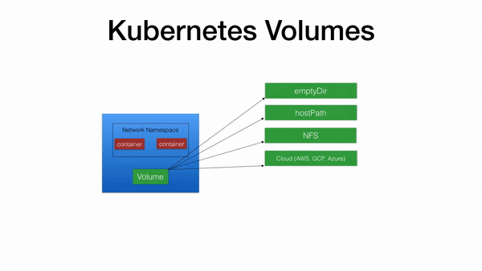

Slide 5
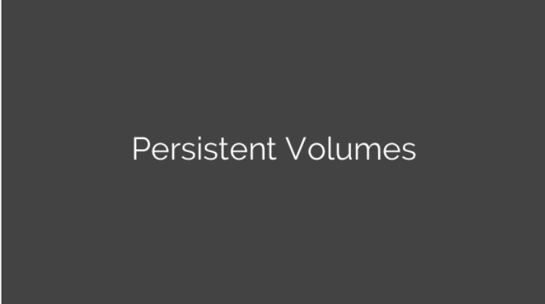

Slide 6
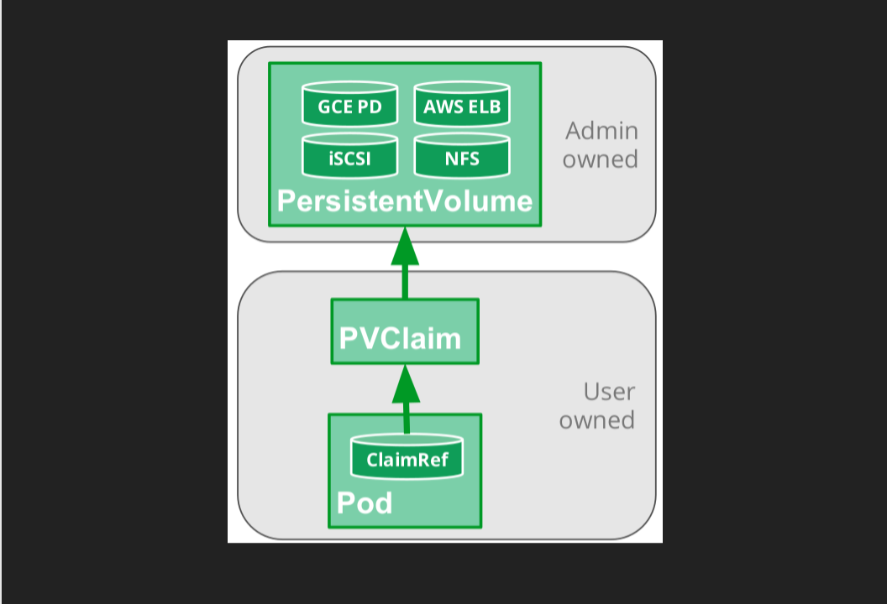

Slide 7
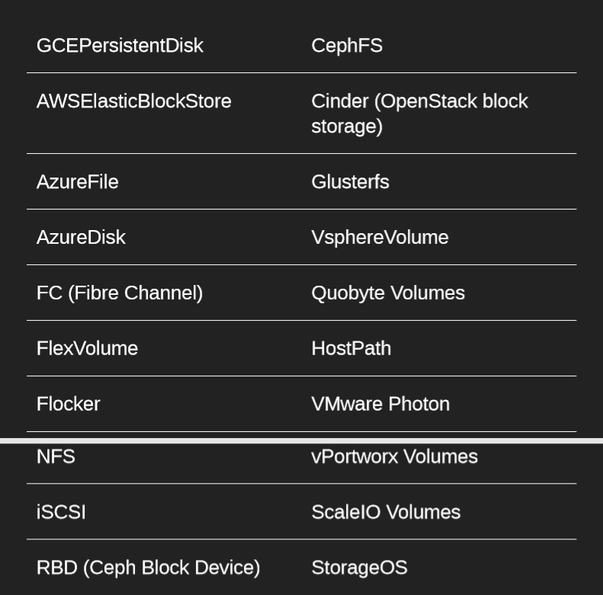

Slide 8
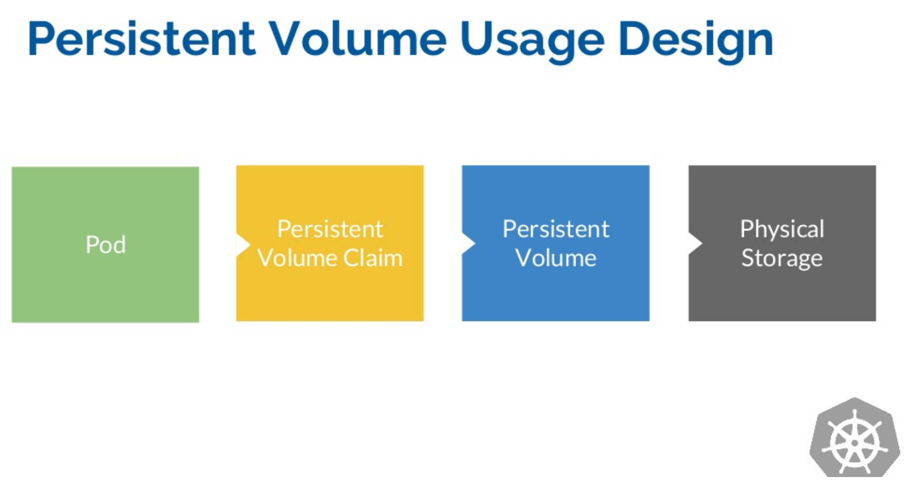

Slide 9
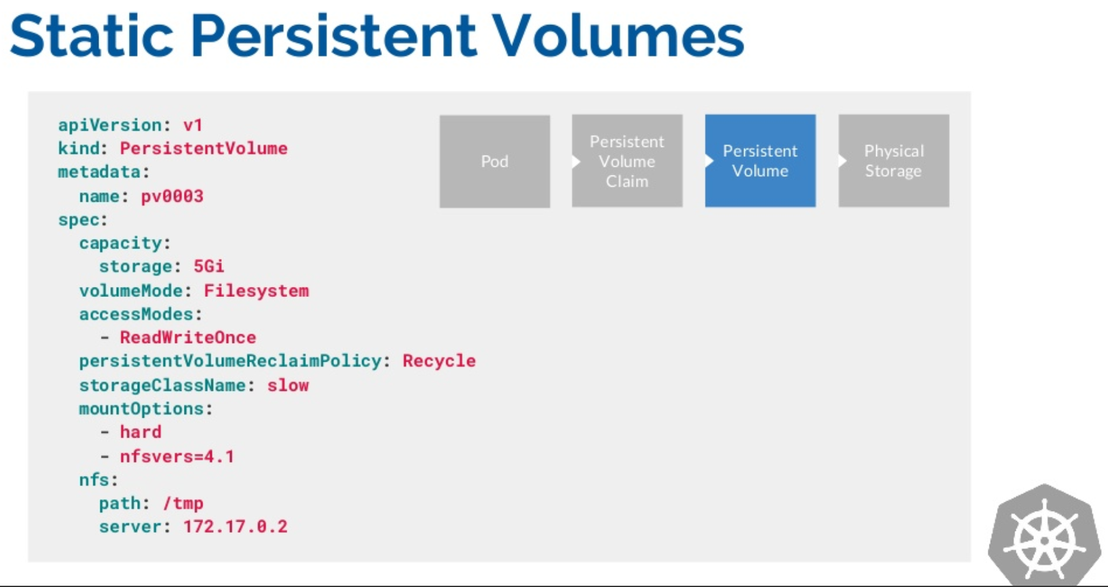

Slide 10
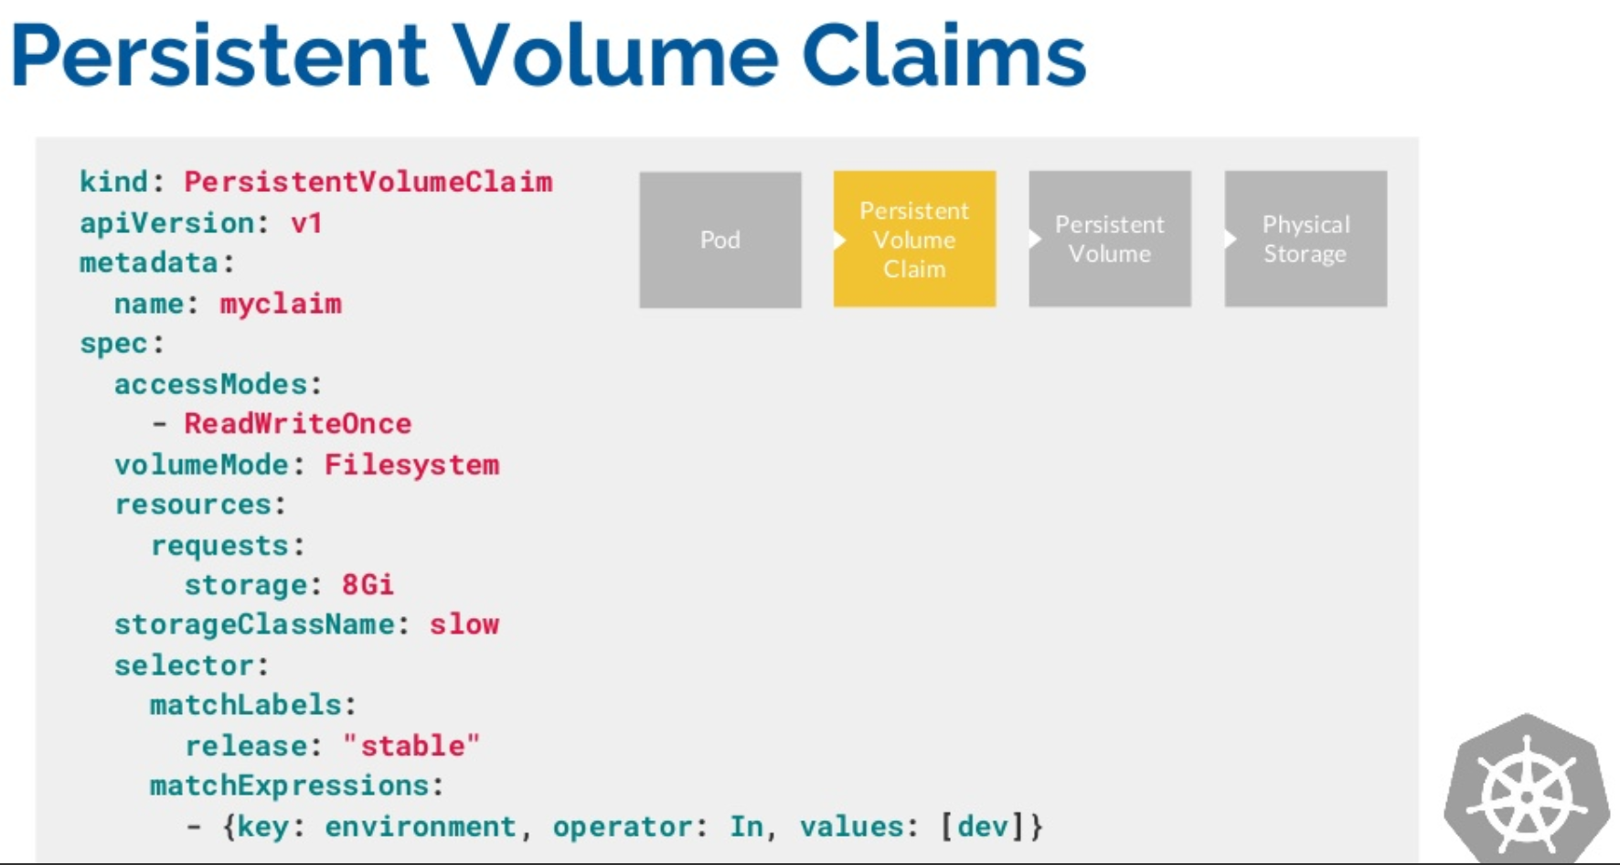

Slide 11
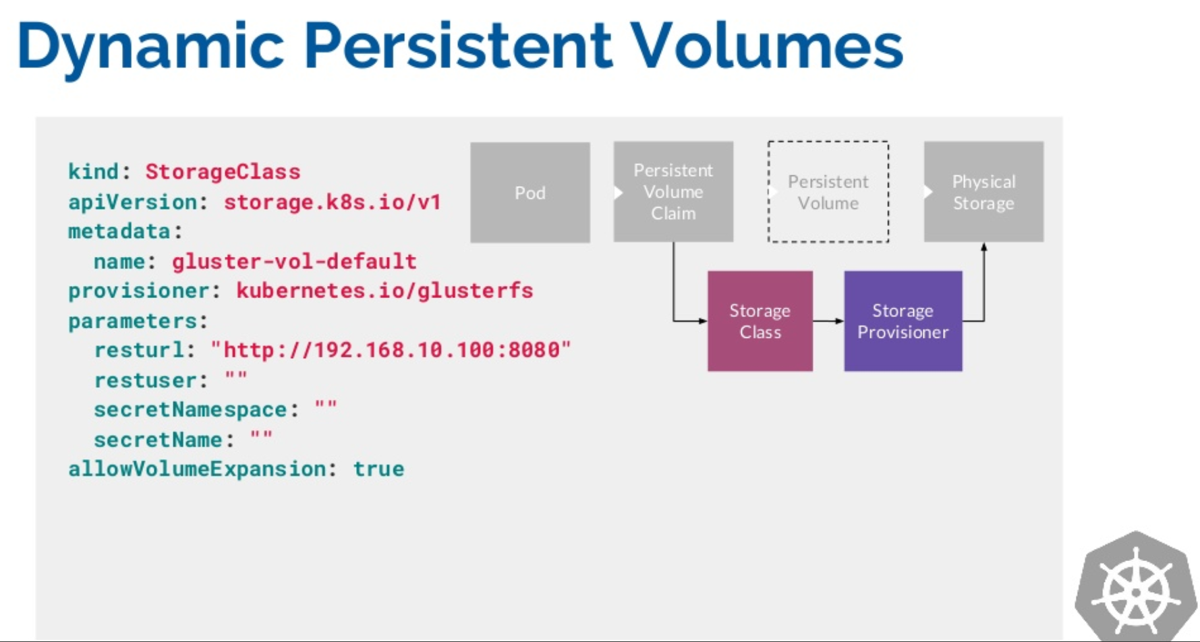

Slide 12
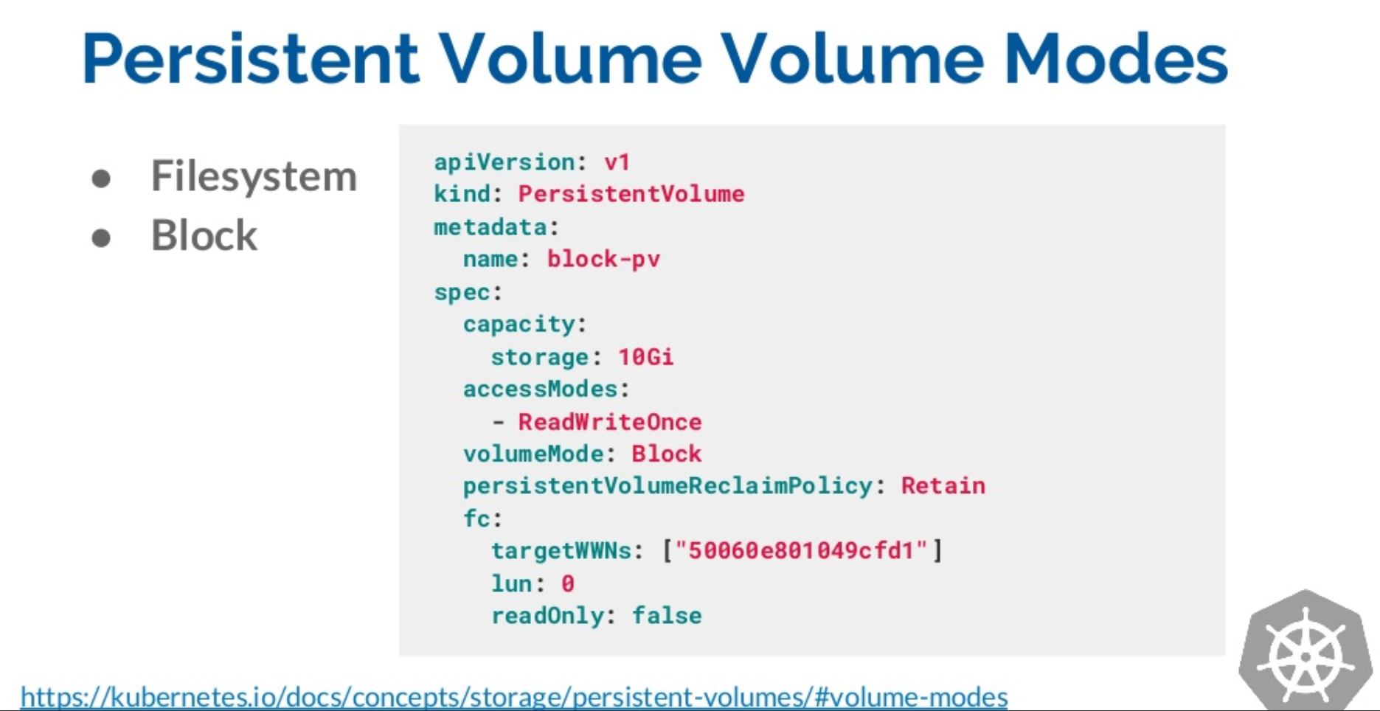

Slide 13
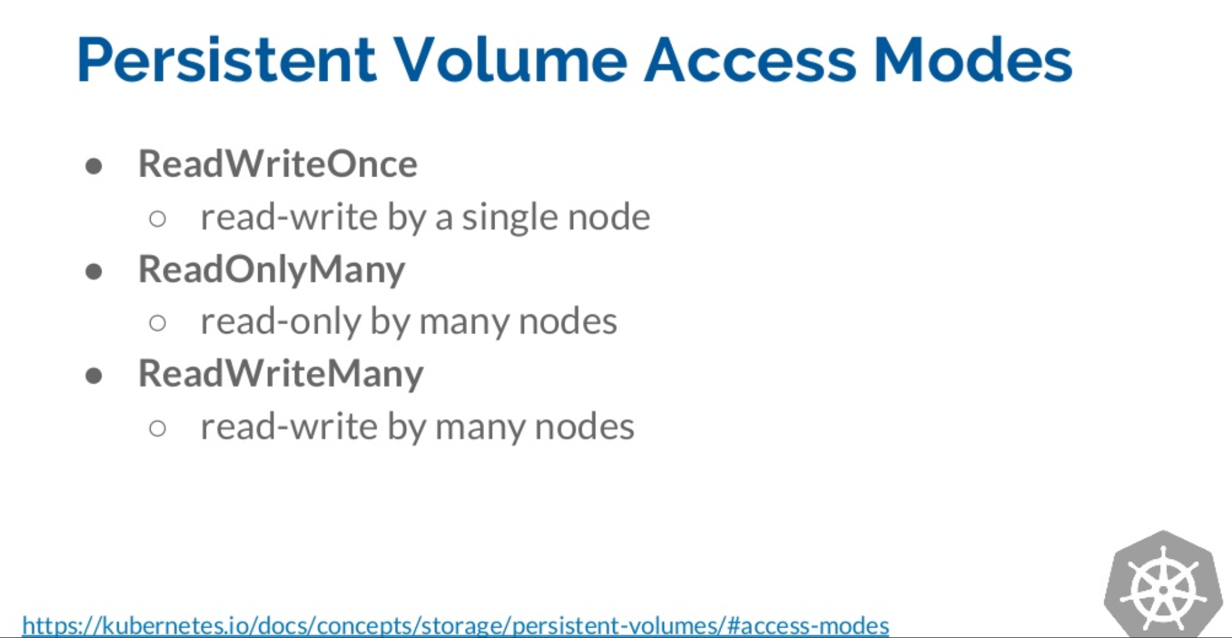

Slide 14
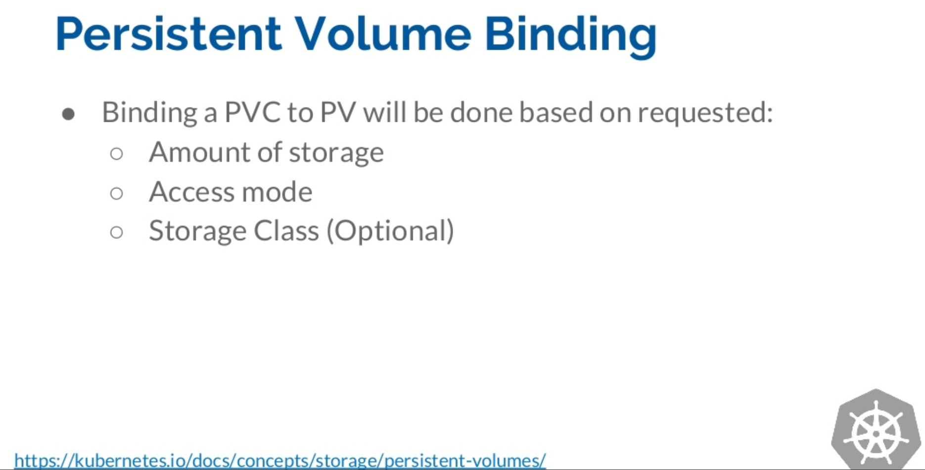

Slide 15
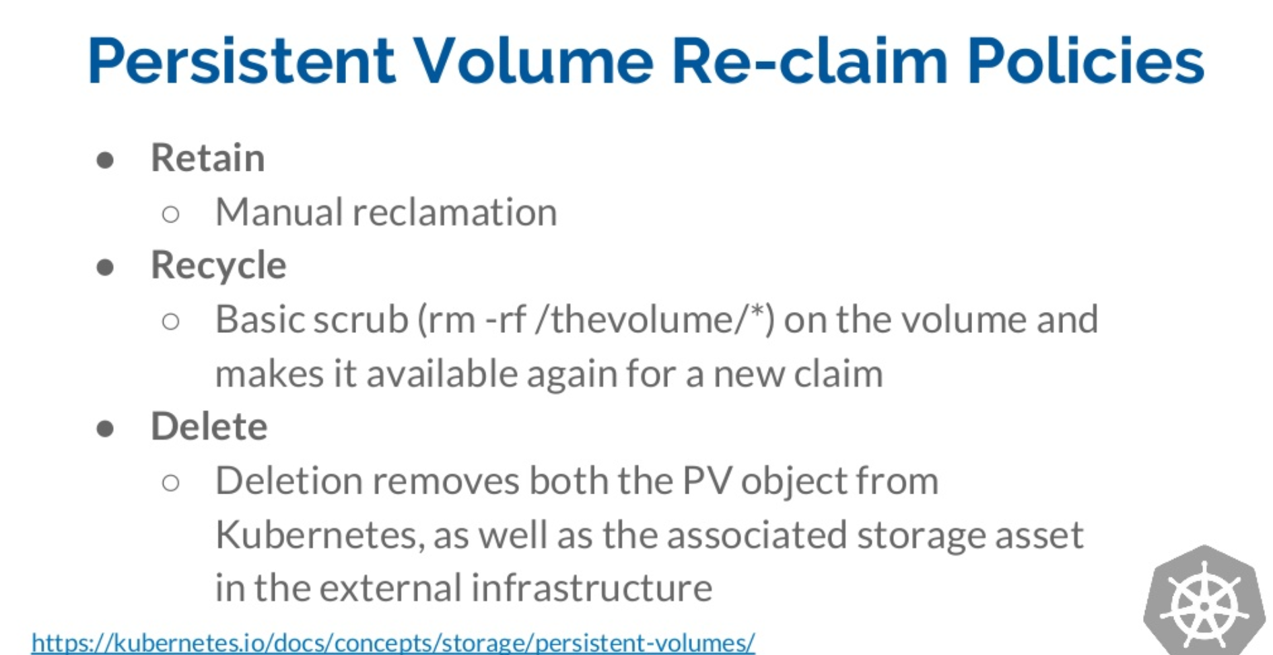

Slide 16
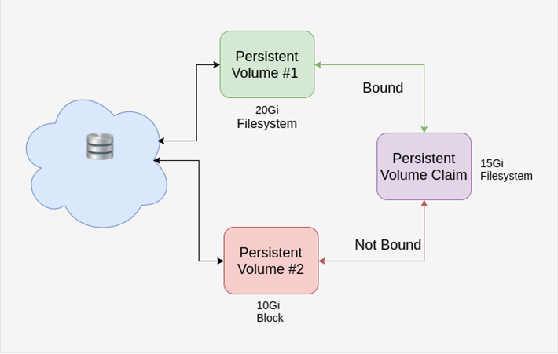

Slide 17
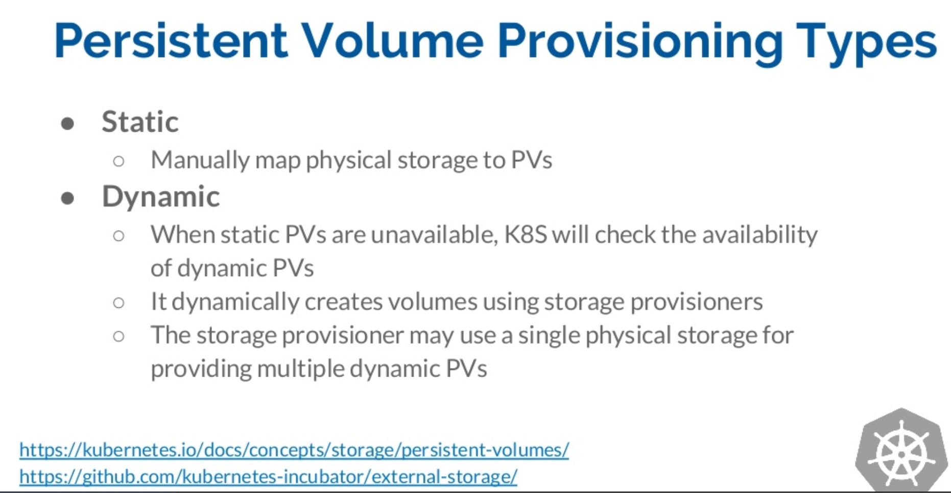

Slide 18
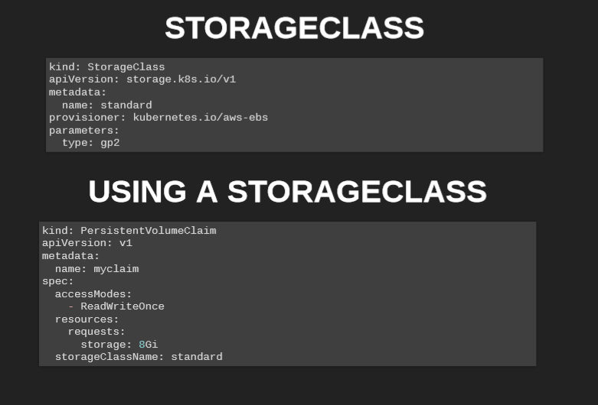

Slide 19
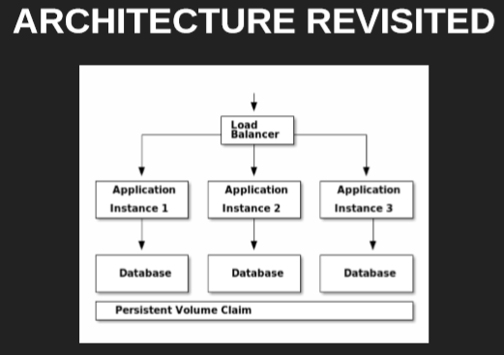
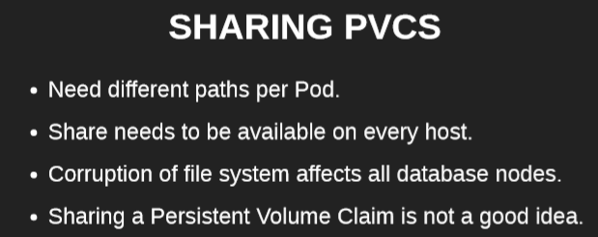

Slide 20
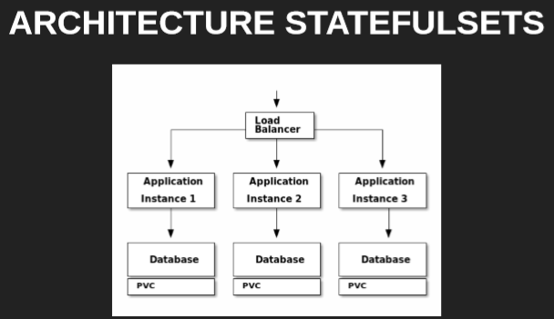
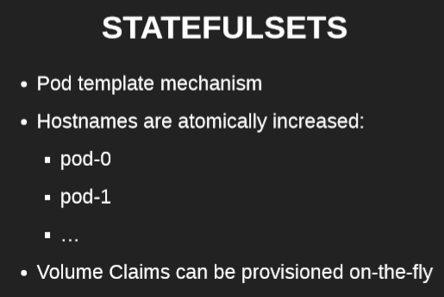
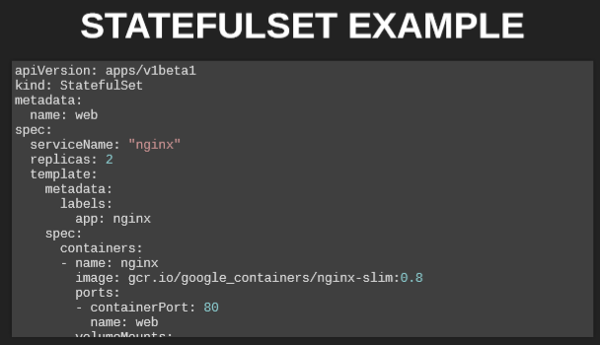

Slide 21

